Slide 1
https://xkcd.com/347/

Slide 2
File Processing & ArrayLists
Nick Troccoli
CS106A, Stanford University

Slide 3

Learning Goals
Know how to read a file line by line.
Know how to store and retrieve data from an ArrayList.

Slide 4
File Processing
Thanks Keith Schwarz for some great slides to build off!

Slide 5
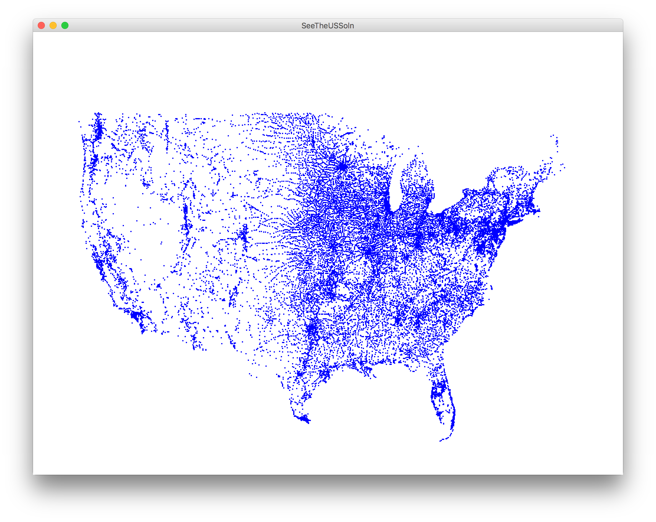
Each blue dot is a tiny GRect
Notes:
Goal: build this census map! But first, why are files important?

Slide 6
Files Are Cool!
Virtually all programs that you've used at some point read files from disk:
Word processing (documents)
Web browser (cookies)
Games (saved progress)
Eclipse (Java files)
Music player (songs)
Notes:
Another source of data.

Slide 7
The structure of files
A file is just a series of bits (ones and zeros).
Those bits can have structure:
Plain-text: Bits represent characters.
JPEG: Bits encode information about the structure of an image.
MP3: Bits encode frequency information about music.
etc.

Slide 8
The structure of files
A file is just a series of bits (ones and zeros).
Those bits can have structure:
Plain-text: Bits represent characters.
JPEG: Bits encode information about the structure of an image.
MP3: Bits encode frequency information about music.
etc.
Notes:
We’re going to focus on text files for now – already seen GImages for images!

Slide 9
Yesterday, upon the stair,
I met a man who wasn’t there
He wasn’t there again today
I wish, I wish he’d go away...
- Hughes Mearns, "Antagonish"

Slide 10
Yesterday, upon the stair,
I met a man who wasn’t there
He wasn’t there again today
I wish, I wish he’d go away...
- Hughes Mearns, "Antagonish"
Step one:
Open the file for reading.

Slide 11
Yesterday, upon the stair,
I met a man who wasn’t there
He wasn’t there again today
I wish, I wish he’d go away...
- Hughes Mearns, "Antagonish"
BufferedReader br =
new BufferedReader(new FileReader("poem.txt"));

Slide 12
Yesterday, upon the stair,
I met a man who wasn’t there
He wasn’t there again today
I wish, I wish he’d go away...
- Hughes Mearns, "Antagonish"
BufferedReader br =
new BufferedReader(new FileReader("poem.txt"));
To use the BufferedReader and FileReader types, you need to
import java.io.*;

Slide 13
Yesterday, upon the stair,
I met a man who wasn’t there
He wasn’t there again today
I wish, I wish he’d go away...
- Hughes Mearns, "Antagonish"
BufferedReader br =
new BufferedReader(new FileReader("poem.txt"));
Notes:
A BufferedReader chops a file into lines and gives them to you one at a time.

Slide 14
Yesterday, upon the stair,
I met a man who wasn’t there
He wasn’t there again today
I wish, I wish he’d go away...
- Hughes Mearns, "Antagonish"
BufferedReader br =
new BufferedReader(new FileReader("poem.txt"));
Step Two:
Read the file,
one line at a time.

Slide 15
Yesterday, upon the stair,
I met a man who wasn’t there
He wasn’t there again today
I wish, I wish he’d go away...
- Hughes Mearns, "Antagonish"
BufferedReader br =
new BufferedReader(new FileReader("poem.txt"));
String line1 = br.readLine();

Slide 16
Yesterday, upon the stair,
I met a man who wasn’t there
He wasn’t there again today
I wish, I wish he’d go away...
- Hughes Mearns, "Antagonish"
BufferedReader br =
new BufferedReader(new FileReader("poem.txt"));
String line1 = br.readLine();

Slide 17
Yesterday, upon the stair,
I met a man who wasn’t there
He wasn’t there again today
I wish, I wish he’d go away...
- Hughes Mearns, "Antagonish"
BufferedReader br =
new BufferedReader(new FileReader("poem.txt"));
String line1 = br.readLine(); // Yesterday, upon the stair,

Slide 18
Yesterday, upon the stair,
I met a man who wasn’t there
He wasn’t there again today
I wish, I wish he’d go away...
- Hughes Mearns, "Antagonish"
BufferedReader br =
new BufferedReader(new FileReader("poem.txt"));
String line1 = br.readLine(); // Yesterday, upon the stair,

Slide 19
Yesterday, upon the stair,
I met a man who wasn’t there
He wasn’t there again today
I wish, I wish he’d go away...
- Hughes Mearns, "Antagonish"
BufferedReader br =
new BufferedReader(new FileReader("poem.txt"));
String line1 = br.readLine(); // Yesterday, upon the stair,
String line2 = br.readLine();

Slide 20
Yesterday, upon the stair,
I met a man who wasn’t there
He wasn’t there again today
I wish, I wish he’d go away...
- Hughes Mearns, "Antagonish"
BufferedReader br =
new BufferedReader(new FileReader("poem.txt"));
String line1 = br.readLine(); // Yesterday, upon the stair,
String line2 = br.readLine();

Slide 21
Yesterday, upon the stair,
I met a man who wasn’t there
He wasn’t there again today
I wish, I wish he’d go away...
- Hughes Mearns, "Antagonish"
BufferedReader br =
new BufferedReader(new FileReader("poem.txt"));
String line1 = br.readLine(); // Yesterday, upon the stair,
String line2 = br.readLine(); // I met a man who wasn't there
Notes:
Can't get same line twice - gumball machine

Slide 22
Yesterday, upon the stair,
I met a man who wasn’t there
He wasn’t there again today
I wish, I wish he’d go away...
- Hughes Mearns, "Antagonish"
BufferedReader br =
new BufferedReader(new FileReader("poem.txt"));
String line1 = br.readLine(); // Yesterday, upon the stair,
String line2 = br.readLine(); // I met a man who wasn't there

Slide 23
Yesterday, upon the stair,
I met a man who wasn’t there
He wasn’t there again today
I wish, I wish he’d go away...
- Hughes Mearns, "Antagonish"
BufferedReader br =
new BufferedReader(new FileReader("poem.txt"));
String line1 = br.readLine(); // Yesterday, upon the stair,
String line2 = br.readLine(); // I met a man who wasn't there
String line3 = br.readLine();

Slide 24
Yesterday, upon the stair,
I met a man who wasn’t there
He wasn’t there again today
I wish, I wish he’d go away...
- Hughes Mearns, "Antagonish"
BufferedReader br =
new BufferedReader(new FileReader("poem.txt"));
String line1 = br.readLine(); // Yesterday, upon the stair,
String line2 = br.readLine(); // I met a man who wasn't there
String line3 = br.readLine();

Slide 25
Yesterday, upon the stair,
I met a man who wasn’t there
He wasn’t there again today
I wish, I wish he’d go away...
- Hughes Mearns, "Antagonish"
BufferedReader br =
new BufferedReader(new FileReader("poem.txt"));
String line1 = br.readLine(); // Yesterday, upon the stair,
String line2 = br.readLine(); // I met a man who wasn't there
String line3 = br.readLine(); // He wasn't there again today

Slide 26
Yesterday, upon the stair,
I met a man who wasn’t there
He wasn’t there again today
I wish, I wish he’d go away...
- Hughes Mearns, "Antagonish"
BufferedReader br =
new BufferedReader(new FileReader("poem.txt"));
String line1 = br.readLine(); // Yesterday, upon the stair,
String line2 = br.readLine(); // I met a man who wasn't there
String line3 = br.readLine(); // He wasn't there again today

Slide 27
Yesterday, upon the stair,
I met a man who wasn’t there
He wasn’t there again today
I wish, I wish he’d go away...
- Hughes Mearns, "Antagonish"
BufferedReader br =
new BufferedReader(new FileReader("poem.txt"));
String line1 = br.readLine(); // Yesterday, upon the stair,
String line2 = br.readLine(); // I met a man who wasn't there
String line3 = br.readLine(); // He wasn't there again today
String line4 = br.readLine();

Slide 28
Yesterday, upon the stair,
I met a man who wasn’t there
He wasn’t there again today
I wish, I wish he’d go away...
- Hughes Mearns, "Antagonish"
BufferedReader br =
new BufferedReader(new FileReader("poem.txt"));
String line1 = br.readLine(); // Yesterday, upon the stair,
String line2 = br.readLine(); // I met a man who wasn't there
String line3 = br.readLine(); // He wasn't there again today
String line4 = br.readLine();

Slide 29
Yesterday, upon the stair,
I met a man who wasn’t there
He wasn’t there again today
I wish, I wish he’d go away...
- Hughes Mearns, "Antagonish"
BufferedReader br =
new BufferedReader(new FileReader("poem.txt"));
String line1 = br.readLine(); // Yesterday, upon the stair,
String line2 = br.readLine(); // I met a man who wasn't there
String line3 = br.readLine(); // He wasn't there again today
String line4 = br.readLine(); // I wish, I wish he'd go away...

Slide 30
Yesterday, upon the stair,
I met a man who wasn’t there
He wasn’t there again today
I wish, I wish he’d go away...
- Hughes Mearns, "Antagonish"
BufferedReader br =
new BufferedReader(new FileReader("poem.txt"));
String line1 = br.readLine(); // Yesterday, upon the stair,
String line2 = br.readLine(); // I met a man who wasn't there
String line3 = br.readLine(); // He wasn't there again today
String line4 = br.readLine(); // I wish, I wish he'd go away...

Slide 31
Yesterday, upon the stair,
I met a man who wasn’t there
He wasn’t there again today
I wish, I wish he’d go away...
- Hughes Mearns, "Antagonish"
BufferedReader br =
new BufferedReader(new FileReader("poem.txt"));
String line1 = br.readLine(); // Yesterday, upon the stair,
String line2 = br.readLine(); // I met a man who wasn't there
String line3 = br.readLine(); // He wasn't there again today
String line4 = br.readLine(); // I wish, I wish he'd go away...
String line5 = br.readLine();

Slide 32
Yesterday, upon the stair,
I met a man who wasn’t there
He wasn’t there again today
I wish, I wish he’d go away...
- Hughes Mearns, "Antagonish"
BufferedReader br =
new BufferedReader(new FileReader("poem.txt"));
String line1 = br.readLine(); // Yesterday, upon the stair,
String line2 = br.readLine(); // I met a man who wasn't there
String line3 = br.readLine(); // He wasn't there again today
String line4 = br.readLine(); // I wish, I wish he'd go away...
String line5 = br.readLine();

Slide 33
Yesterday, upon the stair,
I met a man who wasn’t there
He wasn’t there again today
I wish, I wish he’d go away...
- Hughes Mearns, "Antagonish"
BufferedReader br =
new BufferedReader(new FileReader("poem.txt"));
String line1 = br.readLine(); // Yesterday, upon the stair,
String line2 = br.readLine(); // I met a man who wasn't there
String line3 = br.readLine(); // He wasn't there again today
String line4 = br.readLine(); // I wish, I wish he'd go away...
String line5 = br.readLine(); // - Hughes Mearns, "Antagonish"

Slide 34
Yesterday, upon the stair,
I met a man who wasn’t there
He wasn’t there again today
I wish, I wish he’d go away...
- Hughes Mearns, "Antagonish"
BufferedReader br =
new BufferedReader(new FileReader("poem.txt"));
String line1 = br.readLine(); // Yesterday, upon the stair,
String line2 = br.readLine(); // I met a man who wasn't there
String line3 = br.readLine(); // He wasn't there again today
String line4 = br.readLine(); // I wish, I wish he'd go away...
String line5 = br.readLine(); // - Hughes Mearns, "Antagonish"

Slide 35
Yesterday, upon the stair,
I met a man who wasn’t there
He wasn’t there again today
I wish, I wish he’d go away...
- Hughes Mearns, "Antagonish"
BufferedReader br =
new BufferedReader(new FileReader("poem.txt"));
String line1 = br.readLine(); // Yesterday, upon the stair,
String line2 = br.readLine(); // I met a man who wasn't there
String line3 = br.readLine(); // He wasn't there again today
String line4 = br.readLine(); // I wish, I wish he'd go away...
String line5 = br.readLine(); // - Hughes Mearns, "Antagonish"
String line6 = br.readLine();

Slide 36
Yesterday, upon the stair,
I met a man who wasn’t there
He wasn’t there again today
I wish, I wish he’d go away...
- Hughes Mearns, "Antagonish"
BufferedReader br =
new BufferedReader(new FileReader("poem.txt"));
String line1 = br.readLine(); // Yesterday, upon the stair,
String line2 = br.readLine(); // I met a man who wasn't there
String line3 = br.readLine(); // He wasn't there again today
String line4 = br.readLine(); // I wish, I wish he'd go away...
String line5 = br.readLine(); // - Hughes Mearns, "Antagonish"
String line6 = br.readLine(); // *Returns null*
Notes:
Think of BufferedReaders like a gumball machine.

Slide 37
Yesterday, upon the stair,
I met a man who wasn’t there
He wasn’t there again today
I wish, I wish he’d go away...
- Hughes Mearns, "Antagonish"
BufferedReader br =
new BufferedReader(new FileReader("poem.txt"));
String line1 = br.readLine(); // Yesterday, upon the stair,
String line2 = br.readLine(); // I met a man who wasn't there
String line3 = br.readLine(); // He wasn't there again today
String line4 = br.readLine(); // I wish, I wish he'd go away...
String line5 = br.readLine(); // - Hughes Mearns, "Antagonish"
String line6 = br.readLine(); // *Returns null*
Step Three:
Close the file.

Slide 38
Yesterday, upon the stair,
I met a man who wasn’t there
He wasn’t there again today
I wish, I wish he’d go away...
- Hughes Mearns, "Antagonish"
BufferedReader br =
new BufferedReader(new FileReader("poem.txt"));
String line1 = br.readLine(); // Yesterday, upon the stair,
String line2 = br.readLine(); // I met a man who wasn't there
String line3 = br.readLine(); // He wasn't there again today
String line4 = br.readLine(); // I wish, I wish he'd go away...
String line5 = br.readLine(); // - Hughes Mearns, "Antagonish"
String line6 = br.readLine(); // *Returns null*
br.close();
Notes:
When you’re done: close it so Java knows it can clean it up!
What if you don’t know how long the file is? Ideas? WHILE LOOP
BufferedReader can't look ahead or back for length

Slide 39
Yesterday, upon the stair,
I met a man who wasn’t there
He wasn’t there again today
I wish, I wish he’d go away...
- Hughes Mearns, "Antagonish"
BufferedReader br =
new BufferedReader(new FileReader("poem.txt"));
String line = br.readLine();
while (line != null) { // while there are more lines…
println(line); // print out each line
line = br.readLine();
}
br.close();
Notes:
We can loop until we get back null!

Slide 40
Yesterday, upon the stair,
I met a man who wasn’t there
He wasn’t there again today
I wish, I wish he’d go away...
- Hughes Mearns, "Antagonish"
BufferedReader br =
new BufferedReader(new FileReader("poem.txt"));
String line = br.readLine();
while (line != null) { // while there are more lines…
println(line); // print out each line
line = br.readLine();
}
br.close();

Slide 41
Yesterday, upon the stair,
I met a man who wasn’t there
He wasn’t there again today
I wish, I wish he’d go away...
- Hughes Mearns, "Antagonish"
BufferedReader br =
new BufferedReader(new FileReader("poem.txt"));
String line = br.readLine();
while (line != null) { // while there are more lines…
println(line); // print out each line
line = br.readLine();
}
br.close();

Slide 42
Yesterday, upon the stair,
I met a man who wasn’t there
He wasn’t there again today
I wish, I wish he’d go away...
- Hughes Mearns, "Antagonish"
BufferedReader br =
new BufferedReader(new FileReader("poem.txt"));
String line = br.readLine();
while (line != null) { // while there are more lines…
println(line); // print out each line
line = br.readLine();
}
br.close();

Slide 43
Yesterday, upon the stair,
I met a man who wasn’t there
He wasn’t there again today
I wish, I wish he’d go away...
- Hughes Mearns, "Antagonish"
BufferedReader br =
new BufferedReader(new FileReader("poem.txt"));
String line = br.readLine();
while (line != null) { // while there are more lines…
println(line); // print out each line
line = br.readLine();
}
br.close();

Slide 44
Yesterday, upon the stair,
I met a man who wasn’t there
He wasn’t there again today
I wish, I wish he’d go away...
- Hughes Mearns, "Antagonish"
BufferedReader br =
new BufferedReader(new FileReader("poem.txt"));
String line = br.readLine();
while (line != null) { // while there are more lines…
println(line); // print out each line
line = br.readLine();
}
br.close();

Slide 45
Yesterday, upon the stair,
I met a man who wasn’t there
He wasn’t there again today
I wish, I wish he’d go away...
- Hughes Mearns, "Antagonish"
BufferedReader br =
new BufferedReader(new FileReader("poem.txt"));
String line = br.readLine();
while (line != null) { // while there are more lines…
println(line); // print out each line
line = br.readLine();
}
br.close();

Slide 46
Yesterday, upon the stair,
I met a man who wasn’t there
He wasn’t there again today
I wish, I wish he’d go away...
- Hughes Mearns, "Antagonish"
BufferedReader br =
new BufferedReader(new FileReader("poem.txt"));
String line = br.readLine();
while (line != null) { // while there are more lines…
println(line); // print out each line
line = br.readLine();
}
br.close();

Slide 47
Yesterday, upon the stair,
I met a man who wasn’t there
He wasn’t there again today
I wish, I wish he’d go away...
- Hughes Mearns, "Antagonish"
BufferedReader br =
new BufferedReader(new FileReader("poem.txt"));
String line = br.readLine();
while (line != null) { // while there are more lines…
println(line); // print out each line
line = br.readLine();
}
br.close();
Notes:
1 more thing….files are unreliable! How many people have had corrupted data, or tried to open a file that didn’t exist?

Slide 48
Sometimes things break
Programs sometimes encounter unexpected errors.
Sometimes these are bugs:
Dividing by zero.
Sending a message to a null object.
Sometimes these are due to external factors:
Network errors.
Missing files.
Notes:
throw and catch

Slide 49
Exceptional cases
An exception occurs if Java encounters a case where it can't proceed as normal.
Java requires that your program handle certain types of exceptions.
Think of exceptions as rerouting control in an emergency:
If all goes well, program continues as usual.
If something goes wrong, handle the emergency.
File processing exceptions: file not found, corrupted, etc.
Notes:
How do we handle exceptions in Java? FIRST: tell Java to watch out for exceptions – required!

Slide 50
try-ing your best
To use a method or class that might cause an exception, you must tell Java to try its best, knowing it might fail.
try {
BufferedReader br =
new BufferedReader(new FileReader("poem.txt"));
String line = br.readLine();
while (line != null) { // while there are more lines…
println(line); // print out each line
line = br.readLine();
}
br.close();
}
Notes:
Tells Java where to try its best, but may fail
Not enough! Java needs to know what to do when there’s an exception.

Slide 51
try and catch me
If an exception occurs, you need to tell Java to catch that exception, and what to do after that.
try {
BufferedReader br =
new BufferedReader(new FileReader("poem.txt"));
String line = br.readLine();
while (line != null) { // while there are more lines…
println(line); // print out each line
line = br.readLine();
}
br.close();
} catch (IOException e) {
// Handle the exception if there is one
println("An error occurred: " + e);
}
Notes:
Tells Java where to try its best, but may fail
Not enough! Java needs to know what to do when there’s an exception.

Slide 52
try and catch me
If an exception occurs, you need to tell Java to catch that exception, and what to do after that.
If something
fails up here…
try {
BufferedReader br =
new BufferedReader(new FileReader("poem.txt"));
String line = br.readLine();
while (line != null) { // while there are more lines…
println(line); // print out each line
line = br.readLine();
}
br.close();
} catch (IOException e) {
// Handle the exception if there is one
println("An error occurred: " + e);
}
Notes:
Tells Java where to try its best, but may fail
Not enough! Java needs to know what to do when there’s an exception.

Slide 53
try and catch me
If an exception occurs, you need to tell Java to catch that exception, and what to do after that.
If something
fails up here…
try {
BufferedReader br =
new BufferedReader(new FileReader("poem.txt"));
String line = br.readLine();
while (line != null) { // while there are more lines…
println(line); // print out each line
line = br.readLine();
}
br.close();
} catch (IOException e) {
// Handle the exception if there is one
println("An error occurred: " + e);
}
… we immediately jump down here.
Notes:
Tells Java where to try its best, but may fail
Not enough! Java needs to know what to do when there’s an exception.

Slide 54
try and catch me
If an exception occurs, you need to tell Java to catch that exception, and what to do after that.
try {
BufferedReader br =
new BufferedReader(new FileReader("poem.txt"));
String line = br.readLine();
while (line != null) { // while there are more lines…
println(line); // print out each line
line = br.readLine();
}
br.close();
} catch (IOException e) {
// Handle the exception if there is one
println("An error occurred: " + e);
}
Notes:
How you handle exceptions depends on what you’re doing

Slide 55
try and catch me
If an exception occurs, you need to tell Java to catch that exception, and what to do after that.
try {
BufferedReader br =
new BufferedReader(new FileReader("poem.txt"));
String line = br.readLine();
while (line != null) { // while there are more lines…
println(line); // print out each line
line = br.readLine();
}
br.close();
} catch (IOException e) {
// Handle the exception if there is one
println("An error occurred: " + e);
}
Notes:
How you handle exceptions depends on what you’re doing - maybe crash, maybe not

Slide 56
try and catch me
If an exception occurs, you need to tell Java to catch that exception, and what to do after that.
try {
BufferedReader br =
new BufferedReader(new FileReader("poem.txt"));
String line = br.readLine();
while (line != null) { // while there are more lines…
println(line); // print out each line
line = br.readLine();
}
br.close();
} catch (IOException e) {
// Handle the exception if there is one
throw new RuntimeException(e);
}
Notes:
Maybe you give up and just throw it back up!

Slide 57
try and catch me
If an exception occurs, you need to tell Java to catch that exception, and what to do after that.
try {
BufferedReader br =
new BufferedReader(new FileReader("poem.txt"));
String line = br.readLine();
while (line != null) { // while there are more lines…
println(line); // print out each line
line = br.readLine();
}
br.close();
} catch (IOException e) {
// Handle the exception if there is one
e.printStackTrace();
}
Notes:
Or maybe you print a stack trace

Slide 58
File concepts in one slide
Make a BufferedReader to open a file to read
Use br.readLine to get one line from the file, usually in a loop
Both the above operations are “dangerous” so we need to use a try/catch block
You can either handle the problem or throw a runtime exception
BufferedReader br = new BufferedReader(new FileReader("poem.txt"));
br.readLine(); // returns the next line, or null
try {
// you can do it!
} catch (Exception e){
// ok maybe not
}
throw new RuntimeException(“AHHHH!”);

Slide 59
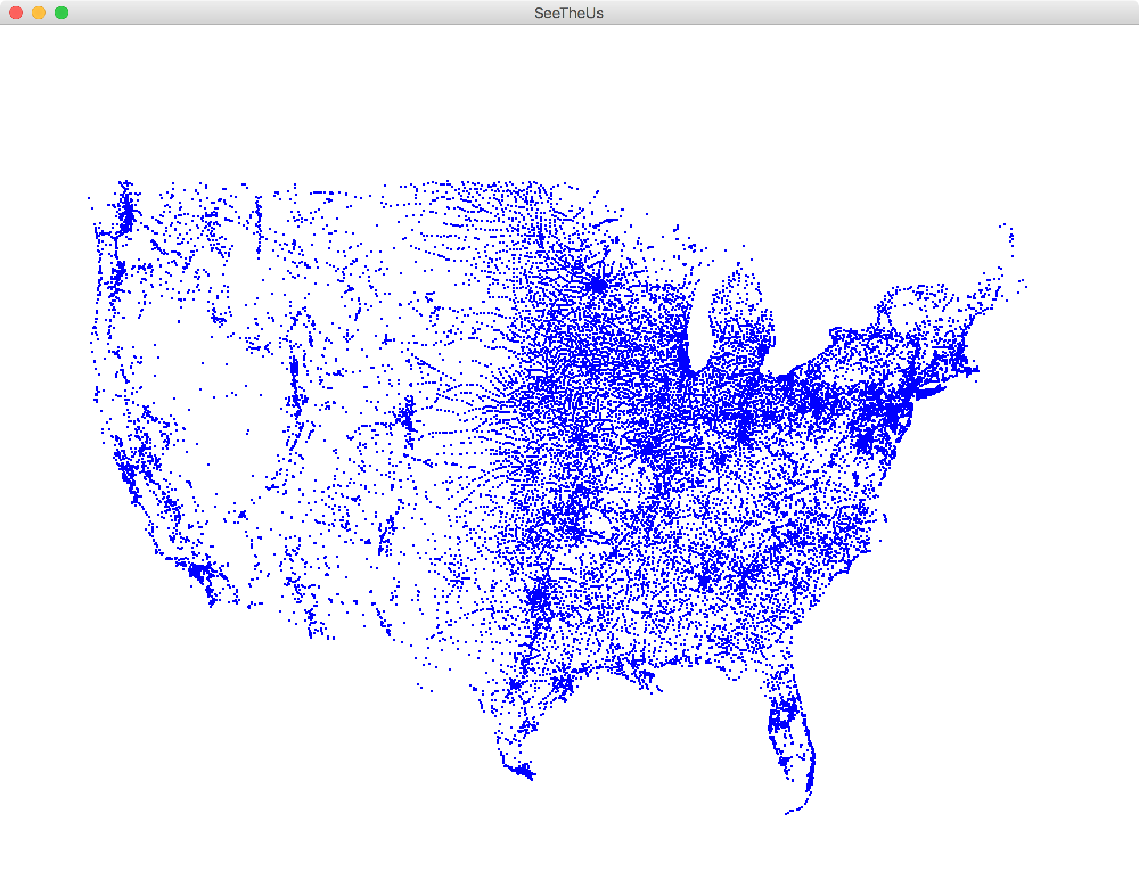
Canonical File Processing Program
try {
BufferedReader br = /*…open the file… */
String line = br.readLine();
while (line != null) {
/* … process current line … */
line = br.readLine(); /* get next line */
}
br.close();
} catch (IOException e) {
throw new RuntimeException(e);
}
Understanding this code is about 95% of what we want you to know for files in CS106A

Slide 60
Example: US Census Data

Slide 61
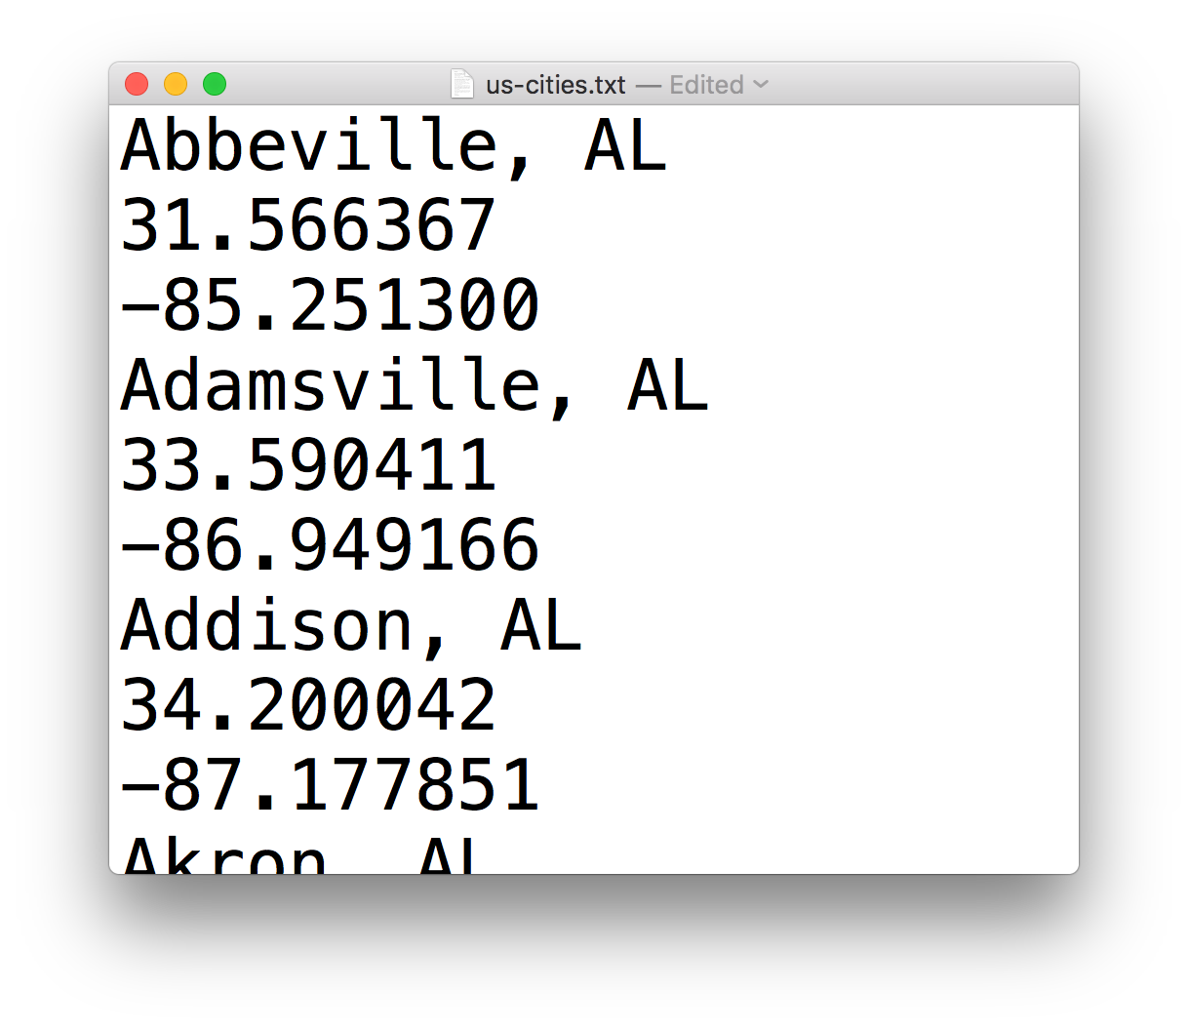
Example: US Census Data

Slide 62
Example: US Census Data
City name

Slide 63
Example: US Census Data
Latitude

Slide 64
Example: US Census Data
Longitude

Slide 65
Example: US Census Data
…
Notes:
Let’s jump over to Eclipse!

Slide 66
Recap: File Processing
Make a BufferedReader to open a file to read
Use br.readLine to get one line from the file, usually in a loop
Both the above operations are “dangerous” so we need to use a try/catch loop
You can either handle the problem or throw a runtime exception
BufferedReader br = new BufferedReader(new FileReader("poem.txt"));
br.readLine(); // returns the next line, or null
try {
// you can do it!
} catch (Exception e){
// ok maybe not
}
throw new RuntimeException(“AHHHH!”);
Notes:
Now, what about if we want to store and manipulate all of the data?
How do we know how many variables to make? We don’t know until the program runs!

Slide 67
ArrayLists
Thanks Keith Schwarz for some great slides to build off!

Slide 68
ArrayList
An ordered, resizable list of information
Homogeneous
Can add and remove elements (among other cool functionality)
Can store any object type
Requires importing java.util.*;
Notes:
An arraylist is like a variable container.

Slide 69
Our First ArrayList
ArrayList<String> myArrayList = new ArrayList<String>();
Notes:
This is how you declare a new ArrayList variable. It’s an OBJECT!

Slide 70
Our First ArrayList
ArrayList<String> myArrayList = new ArrayList<String>();

Slide 71
Our First ArrayList
Type of thing your ArrayList will store.
ArrayList<String> myArrayList = new ArrayList<String>();
Notes:
What type of thing are you going to store?

Slide 72
Our First ArrayList
ArrayList<String> myArrayList = new ArrayList<String>();

Slide 73
Our First ArrayList
ArrayList<String> myArrayList = new ArrayList<String>();

Slide 74
Our First ArrayList
Same type here, but followed by ().
ArrayList<String> myArrayList = new ArrayList<String>();

Slide 75
Our First ArrayList
ArrayList<String> myArrayList = new ArrayList<String>();
Notes:
So now that we’ve created an arraylist, what can we do with it? Lots!

Slide 76
Our First ArrayList
ArrayList<String> myArrayList = new ArrayList<String>();
// Adds elements to the back
myArrayList.add(“hi”);
Notes:
We can add things to it

Slide 77
Our First ArrayList
ArrayList<String> myArrayList = new ArrayList<String>();
// Adds elements to the back
myArrayList.add(“hi”);
myArrayList.add(“there”);
Notes:
We can add things to it

Slide 78
Our First ArrayList
ArrayList<String> myArrayList = new ArrayList<String>();
// Adds elements to the back
myArrayList.add(“hi”);
myArrayList.add(“there”);
// Access elements by index (starting at 0!)
println(myArrayList.get(0)); // prints “hi”
println(myArrayList.get(1)); // prints “there”
Notes:
A few things to watch out for…

Slide 79
Our First ArrayList
ArrayList<String> myArrayList = new ArrayList<String>();
// Adds elements to the back
myArrayList.add(“hi”);
myArrayList.add(“there”);
// Access elements by index (starting at 0!)
println(myArrayList.get(0)); // prints “hi”
println(myArrayList.get(1)); // prints “there”
// Wrong type - bad times! Won’t compile
GLabel label = new Glabel(“hi there”);
myArrayList.add(label);
Notes:
Can only add the type of objects we said we would

Slide 80
Our First ArrayList
ArrayList<String> myArrayList = new ArrayList<String>();
// Adds elements to the back
myArrayList.add(“hi”);
myArrayList.add(“there”);
// Access elements by index (starting at 0!)
println(myArrayList.get(0)); // prints “hi”
println(myArrayList.get(1)); // prints “there”
// Wrong type - bad times! Won’t compile
GLabel label = new Glabel(“hi there”);
myArrayList.add(label);
// Invalid index – crashes! IndexOutOfBounds Exception
println(myArrayList.get(2));
Notes:
Can’t access elements that don’t exist!
Now, ArrayLists’ indices work great with for loops!

Slide 81
Our First ArrayList
ArrayList<String> myArrayList = new ArrayList<String>();
// Adds elements to the back
myArrayList.add(“hi”);
myArrayList.add(“there”);
// Access elements by index (starting at 0!)
for (int i = 0; i < myArrayList.size(); i++) {
println(myArrayList.get(i));
}
// hi
// there
Notes:
Can loop over every element in an Arraylist, kind of like a string.
But unlike a string, you can change elements in an arraylist!
What else can you do with an ArrayList?

Slide 82
Methods in the ArrayList Class
boolean add(<T> element)
Adds a new element to the end of the ArrayList; the return value is always true.
void add(int index, <T> element)
Inserts a new element into the ArrayList before the position specified by index.
<T> remove(int index)
Removes the element at the specified position and returns that value.
boolean remove(<T> element)
Removes the first instance of element, if it appears; returns true if a match is found.
void clear()
Removes all elements from the ArrayList.
int size()
Returns the number of elements in the ArrayList.
<T> get(int index)
Returns the object at the specified index.
<T> set(int index, <T> value)
Sets the element at the specified index to the new value and returns the old value.
int indexOf(<T> value)
Returns the index of the first occurrence of the specified value, or -1 if it does not appear.
boolean contains(<T> value)
Returns true if the ArrayList contains the specified value.
boolean isEmpty()
Returns true if the ArrayList contains no elements.
Using portions of slides by Eric Roberts
Notes:
What is this <T>? <T> is a placeholder for the type of thing the arrayList stores. Since you can specify any type you want, the documentation puts <T> in place of the type you choose. So if you choose String, in your mind replace <T> with String. Etc.
This all seems great! This must be too good to be true…

Slide 83
ArrayLists + Primitives = 💔
// Doesn’t compile ☹
ArrayList<int> myArrayList = new ArrayList<int>();
ArrayLists can only store objects!
Notes:
One caveat: can only store objects…
So what did Java do? Patch fix! They made *object versions of each primitive”
This seems hacky…..

Slide 84
ArrayLists + Primitives = 💔
Primitive | “Wrapper” Class
int | Integer
double | Double
boolean | Boolean
char | Character
Notes:
Good news: Java takes care of the conversion for you!

Slide 85
ArrayLists + Wrappers = ❤️️
// Just use wrapper class when making an ArrayList
ArrayList<Integer> numList = new ArrayList<Integer>();
numList.add(123);
numList.add(546);
int firstNum = numList.get(0); // 123
int secondNum = numList.get(1); // 456
Conversion happens automatically!
Notes:
Boxing -> “boxing an int up into an Integer and putting in the ArrayList
Unboxing -> unboxing an Integer back into an int
“Autoboxing”
Let’s look at a demo!

Slide 86
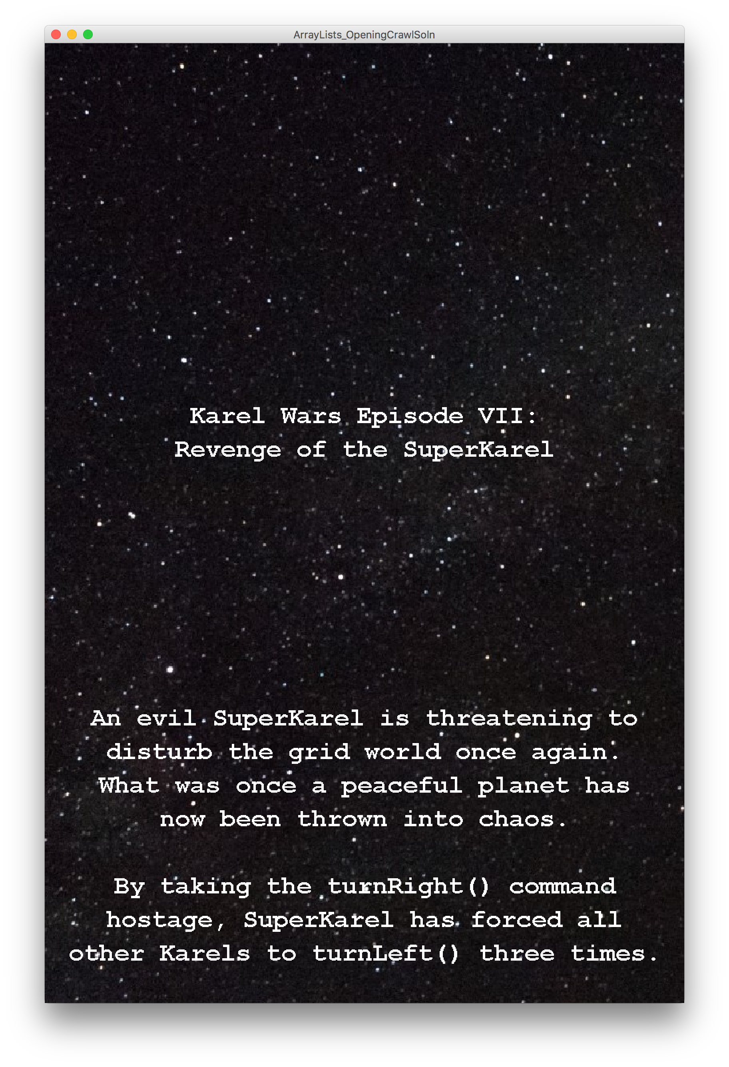
Demo: File Processing + ArrayLists
Notes:
Let’s look at a demo!

Slide 87
Summary of Today
BufferedReaders let us read a file line by line.
Since bad things can happen outside our control when reading files, we must use try/catch.
ArrayLists are homogeneous lists of objects.
You can add, remove, get, find, etc. on ArrayLists.
Notes:
An arraylist is like a variable container.

Slide 88
ArrayList
Good luck on the midterm!
Notes:
An arraylist is like a variable container.

